Slide 1

Statistical Computation Methods for Data Science
Unit-I
Lecture - 7
S U RAVI KUMAR CHAVALI
Assistant Professor
Department of Science and Humanities
SNIST

Slide 2
We discuss the following in today’s Lecture
Moments
Moments about a point
Raw moments
Central moments

Slide 3
Moments
Moments are a set of statistical parameters, which can be used to calculate the mean, variance, and skewness from the distributions. There are Four moments which are commonly used:
Mean: the average
Variance:
Standard deviation
Skewness: measure the asymmetry of a distribution about its peak; it is a number that describes the shape of the distribution.
Kurtosis: measures the peakedness or flatness of a distribution.

Slide 4
Moments
The mean and the variance provide information on the location and variability of a set of numbers, and by doing so, provide some information on the appearance of the distribution of the numbers. The mean and variance are the first two statistical moments, and the third and fourth moments also provide information on the shape of the distribution.

Slide 5
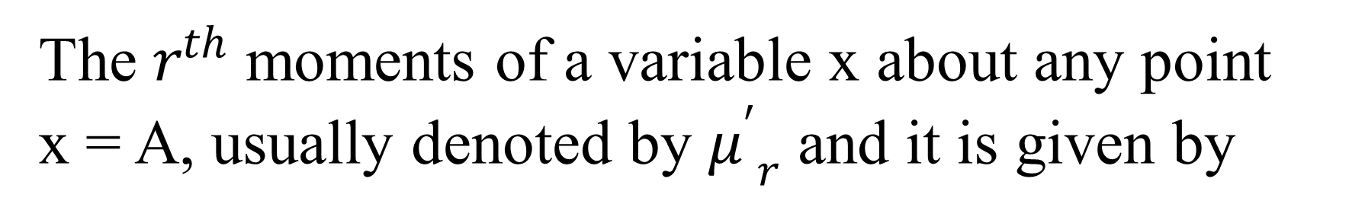
Moments about a point
The $r^{th}$ moments of a variable x about any point
x = A, usually denoted by ${μ^{′}}_{r}$ and it is given by
For Ungrouped Data,
For Grouped Data

Slide 6
Moments about a point(For Grouped Data)
If Class Interval frequency distribution is given then, the mean deviation about a point x=A is given by,
Where x_{i} is the mid value of the class interval.

Slide 7
Note: consider..
Taking r=1, we get

Slide 8
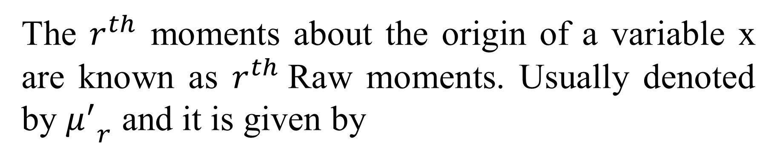
Raw moments
The $r^{th}$ moments about the origin of a variable x are known as $r^{th}$Raw moments. Usually denoted by ${μ^{′}}_{r}$ and it is given by
For Ungrouped Data,
For Discrete Data

Slide 9
For Grouped Data
If Class Interval frequency distribution is given then, the moments about origin is given by,
Where x_{i} is the mid value of the class interval.

Slide 10
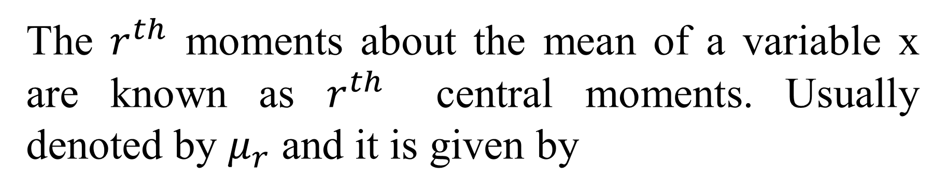
Central moments
The $r^{th}$ moments about the mean of a variable x are known as $r^{th}$ central moments. Usually denoted by $μ_{r}$ and it is given by
For Ungrouped Data
For Discrete Data

Slide 11
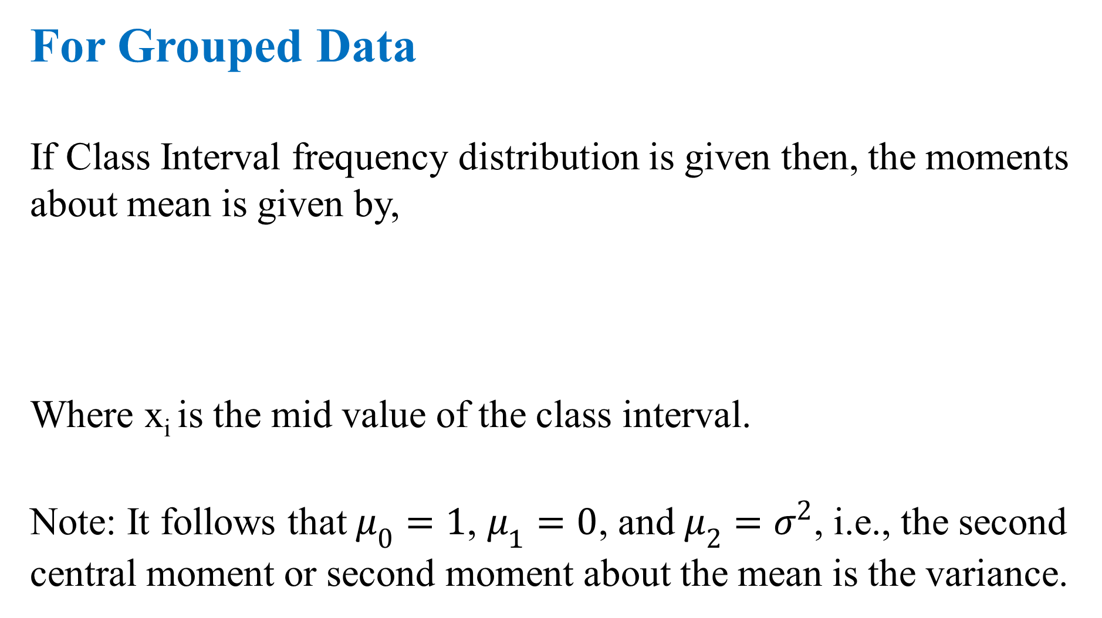
For Grouped Data
If Class Interval frequency distribution is given then, the moments about mean is given by,
Where x_{i} is the mid value of the class interval.
Note: It follows that $μ_{0}=1$, $μ_{1}=0$, and $μ_{2}=σ^{2}$, i.e., the second central moment or second moment about the mean is the variance.

Slide 12
The relationship between these moments is given by
Note: As special cases we have, using${{ μ}^{′}}_{1}=μ$, ${{ μ}^{′}}_{0}=1$

Slide 13
Relationship between moments and central moments:
These formulae enable us to find moments about any point, once the mean and the moments about mean are known.

Slide 14
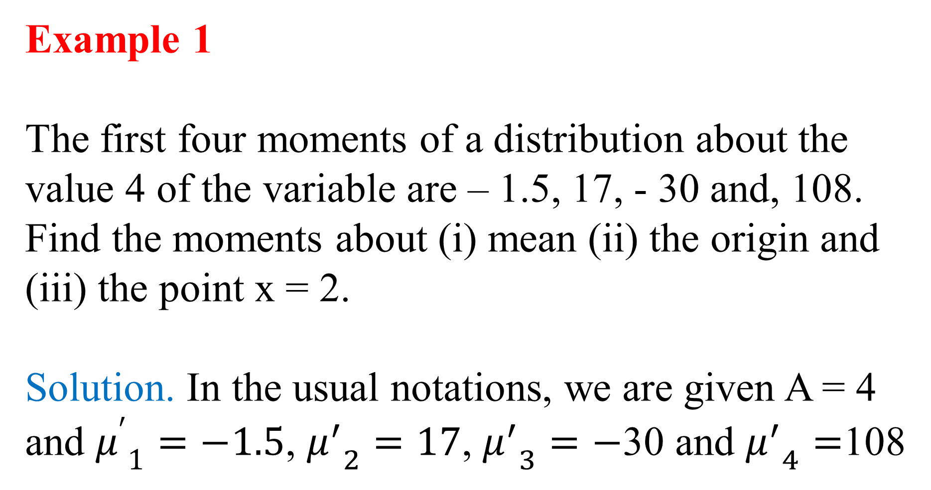
Example 1
The first four moments of a distribution about the value 4 of the variable are – 1.5, 17, - 30 and, 108. Find the moments about (i) mean (ii) the origin and (iii) the point x = 2.
Solution. In the usual notations, we are given A = 4 and ${μ^{′}}_{1}=−1.5$, ${μ^{′}}_{2}=17$, ${μ^{′}}_{3}=−$30 and ${μ^{′}}_{4}=$108

Slide 15
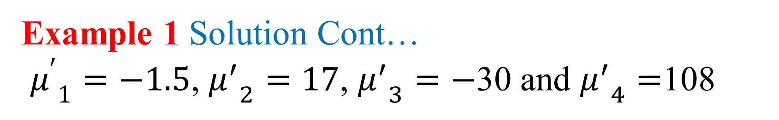
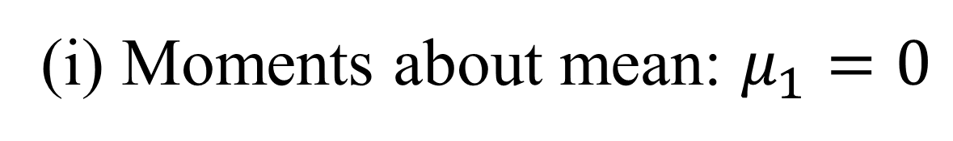
Example 1 Solution Cont…
${μ^{′}}_{1}=−1.5$, ${μ^{′}}_{2}=17$, ${μ^{′}}_{3}=−$30 and ${μ^{′}}_{4}=$108
(i) Moments about mean: $μ_{1}=0$

Slide 16
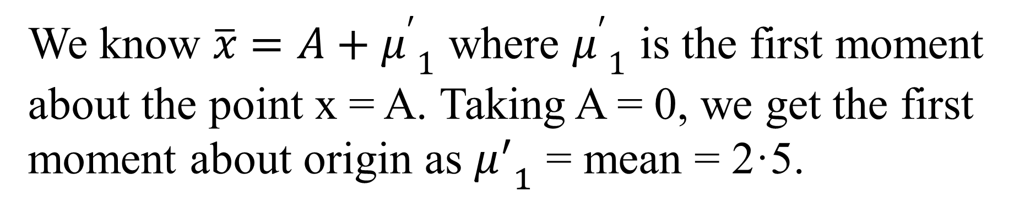
Example 1 Solution Cont…
(ii) Moments about origin:
We know $\overline{x}=A+{μ^{′}}_{1}$ where ${μ^{′}}_{1}$ is the first moment about the point x = A. Taking A = 0, we get the first moment about origin as ${μ^{′}}_{1}$ = mean = 2·5.

Slide 17
Example 1 Solution Cont…

Slide 18
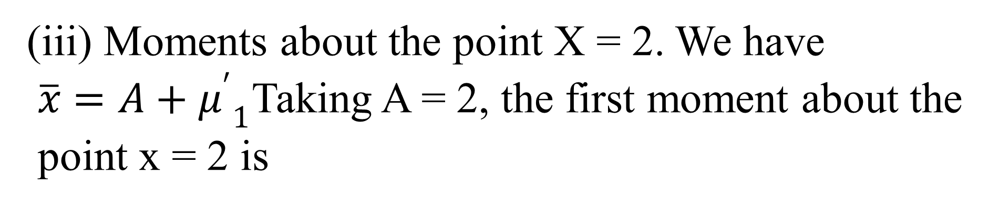
Example 1 Solution Cont…
(iii) Moments about the point X = 2. We have
$\overline{x}=A+{μ^{′}}_{1}$Taking A = 2, the first moment about the
point x = 2 is

Slide 19

Example 2
Calculate the first four moments about mean for the following frequency distribution:
Ans:
Weights (grams) | Frequency (f)
0 | 1
1 | 8
2 | 28
3 | 56
4 | 70
5 | 56
6 | 28
7 | 8
8 | 1
$$μ_{1}=0$$

Slide 20
Soln:
Weights (grams) ( x) | Frequency (f) | d | f.d² | f.d³ | f.d⁴
0 | 1
1 | 8
2 | 28
3 | 56
4 | 70
5 | 56
6 | 28
7 | 8
8 | 1

Slide 21
Example 3
Calculate first four moments about the mean for the following set of examination marks:
X: 45 32 37 46 39 36 41 48 36

Slide 22
Soln:
x | d | d² | d³ | d⁴

Slide 23
Example 4
Calculate: first four moments about mean for the following frequency distribution:
Weights (grams) | Frequency (f)
65-84 | 9
85-104 | 10
105-124 | 17
125-144 | 10
145-164 | 5
165-184 | 4
185-204 | 5
Total | 60

Slide 24
Soln:
C.I | x | Frequency (f) | d | f.d² | f.d³ | f.d⁴

Slide 25
Recapitulation:
Moments
Moments about a point
Raw moments
Central moments

Slide 26

Thank you all
31 July 2019

